Slide 1
Chapter 16
Fourier Analysis with MATLAB
Fourier analysis is the process of representing a function in terms of sinusoidal components. It is widely employed in many areas of engineering, science, and applied mathematics. It provides information as to what frequency components represent a function. Some basic principles and the means for performing the analysis with MATLAB will be considered in this chapter.

Slide 2
Initial Assumptions
Since many of the variables for which Fourier analysis is required are functions of time t, we will use it as the independent variable. The dependent variable will be denoted as x(t). The function x(t) is said to be in the time domain and the Fourier representation is said to be in the frequency domain. The frequency domain form is called the spectrum. We will first consider the spectra of periodic functions. A periodic function satisfies x(t) = x(t+T)

Slide 3
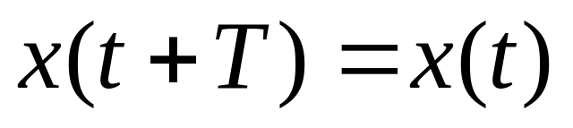
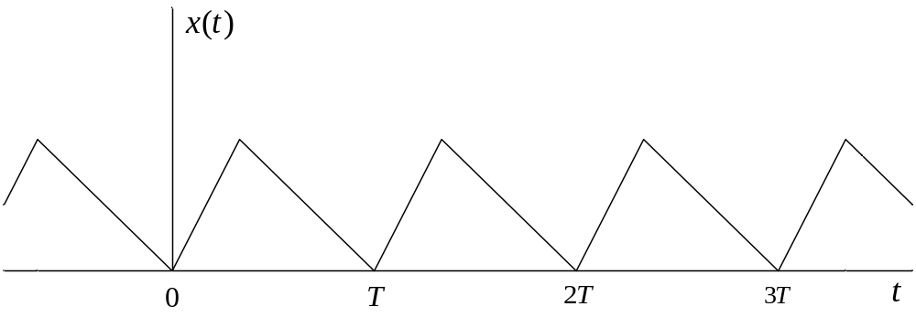
Periodic Function
The function below is an example of a periodic function with period T.

Slide 4
Fourier Series for Periodic Functions
Spectral analysis of periodic functions is achieved through the Fourier series. The 3 forms are
(1) cosine-sine form,
(2) amplitude-phase form, and
(3) complex exponential form.
(1) and (2) are referred to as one-sided forms and (3) will be referred to as a two-sided form. A constant term in the series is often called the dc value.

Slide 5
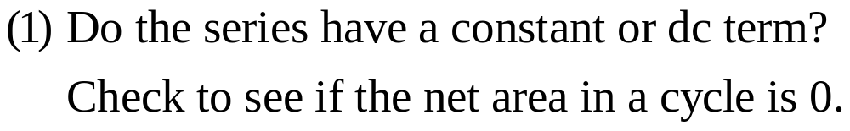
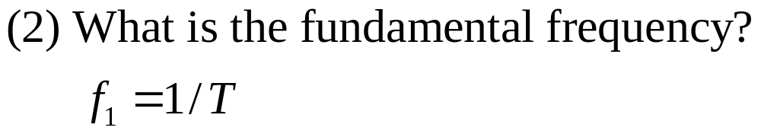
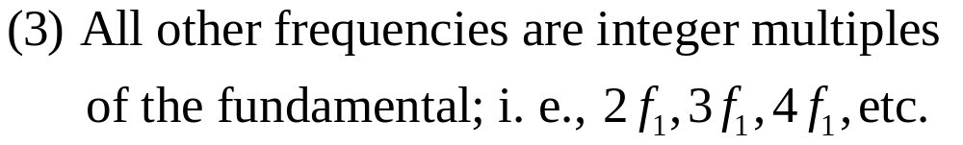
Simple Initial Analysis

Slide 6
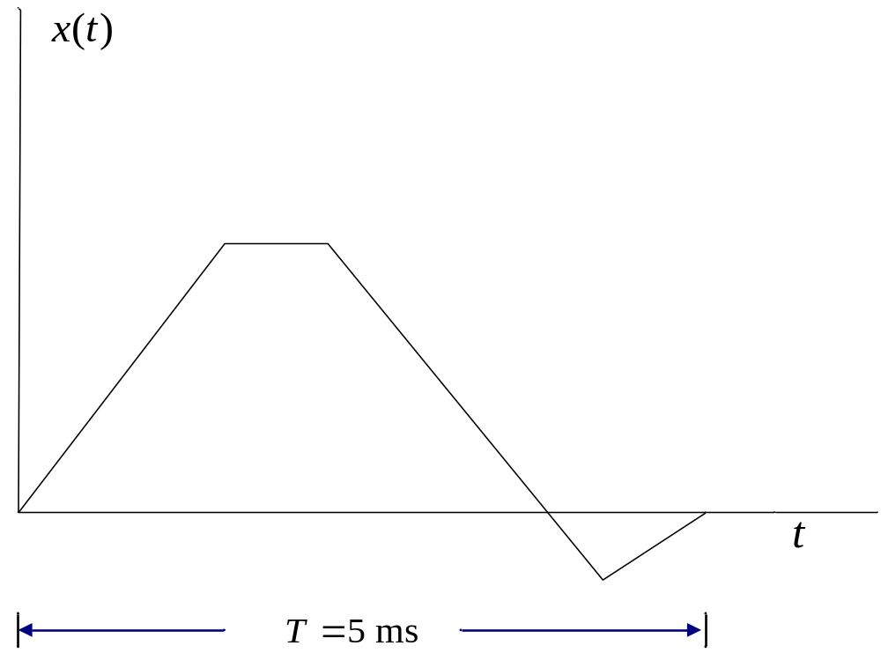
Example 16-1. List frequencies for the assumed periodic waveform below.
Only one cycle is shown.

Slide 7
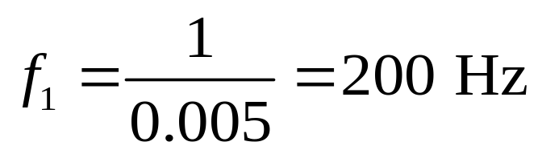
Example 16-1. Continuation.
Since the positive area is clearly greater than the negative area, there will be a constant or dc term in the series.
The frequencies are
0 (dc)
200 Hz
400 Hz
600 Hz
800 Hz, etc.

Slide 8
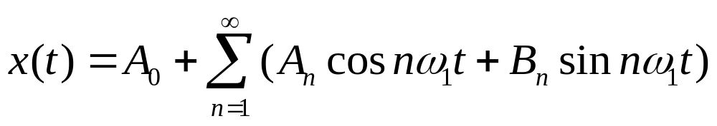
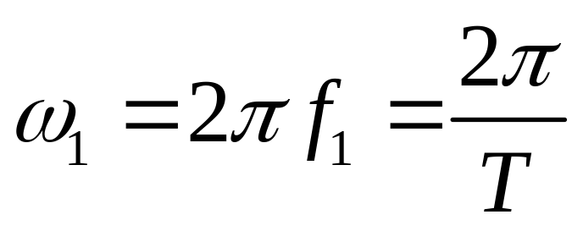
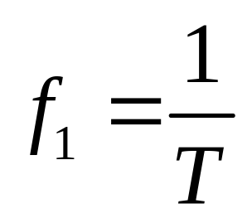
Fourier Series Cosine-Sine Form

Slide 9
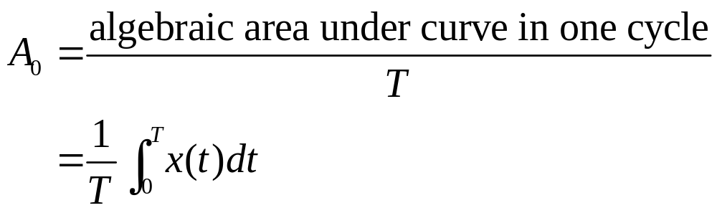
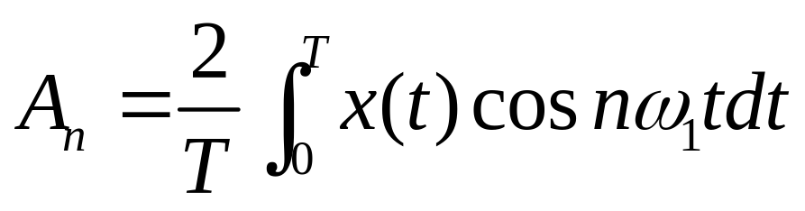
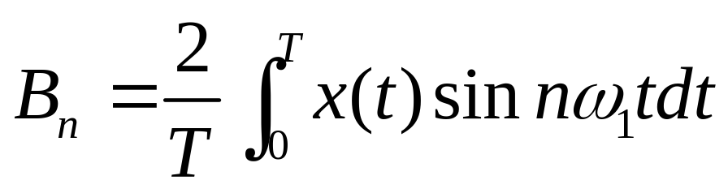
Fourier Series Cosine-Sine Form
(Continuation)

Slide 10
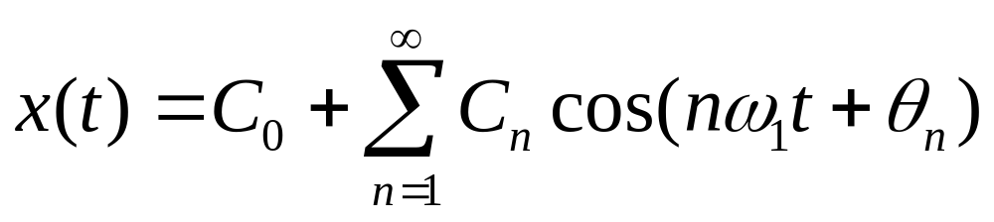
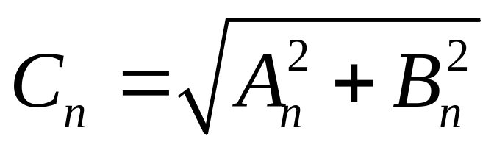
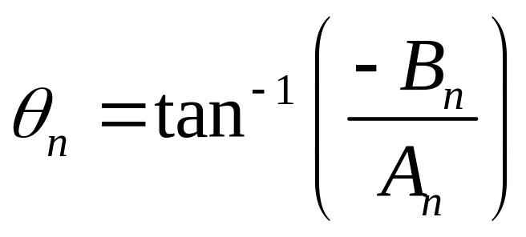
Fourier Series Amplitude-Phase Form

Slide 11
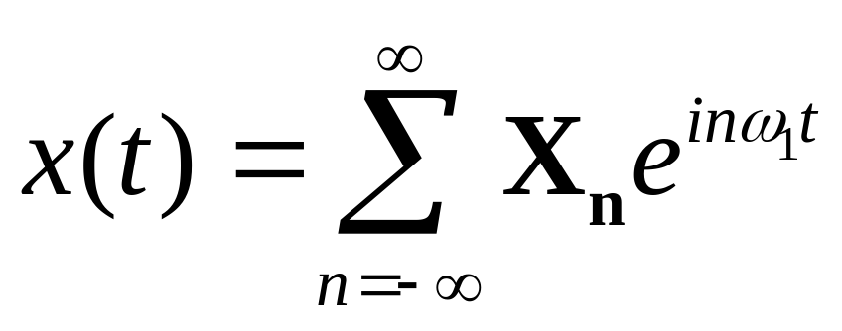
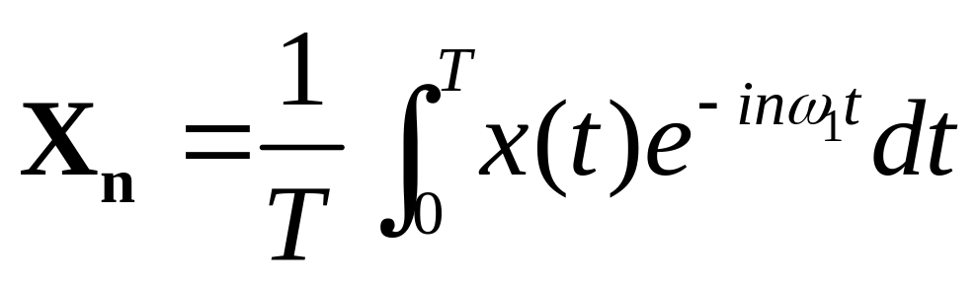
Fourier Series Complex Exponential Form

Slide 12
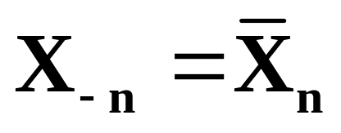
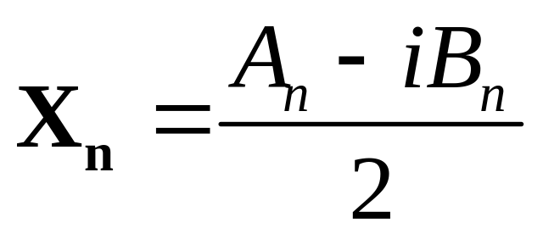
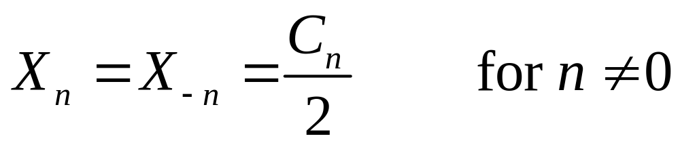
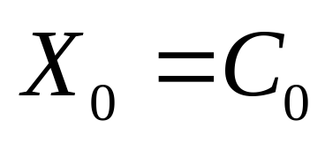
Some Relationships

Slide 13
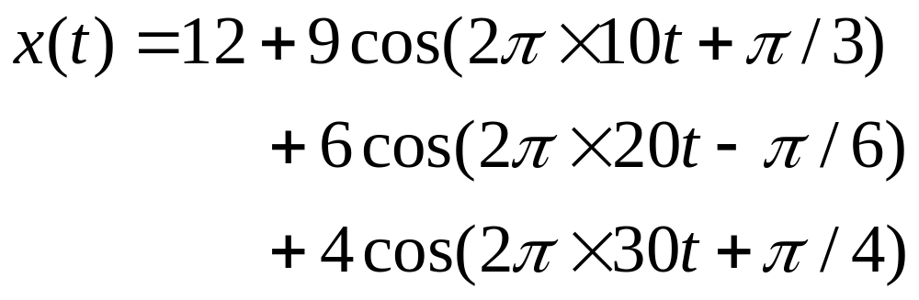
Example 16-2. A Fourier series is given below. List frequencies and plot the one-sided amplitude spectrum.
The frequencies are
0 (dc)
10 Hz
20 Hz
30 Hz

Slide 14
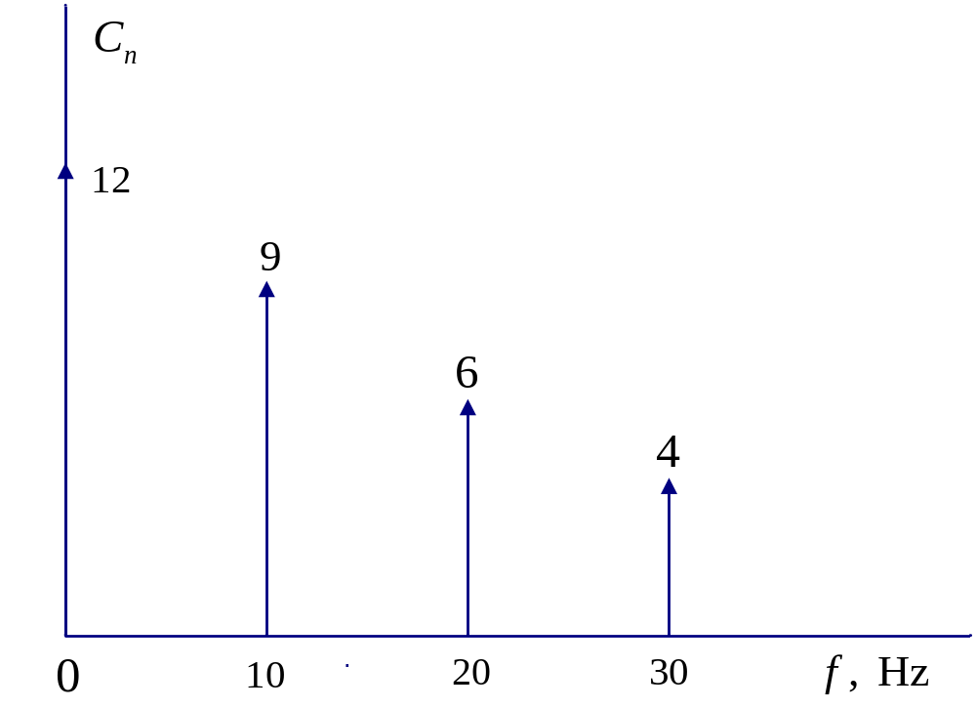
One-Sided Amplitude Spectrum of Example 16-2

Slide 15
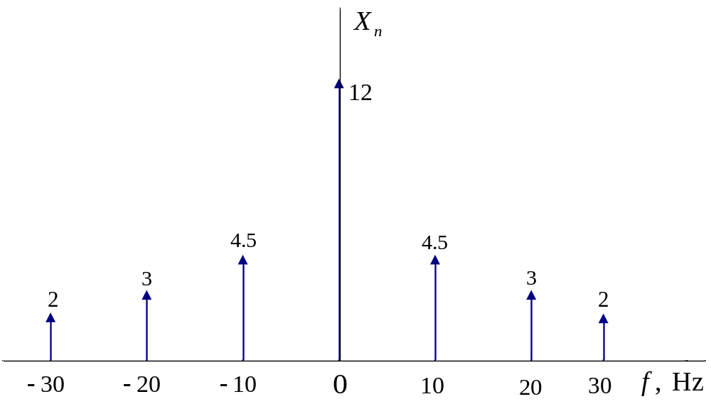
Two-Sided Amplitude Spectrum of Example 16-3

Slide 16
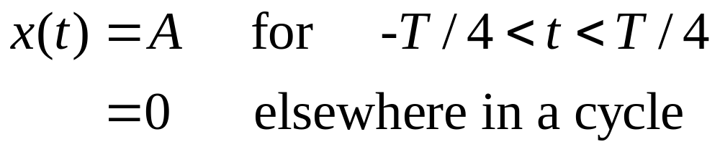
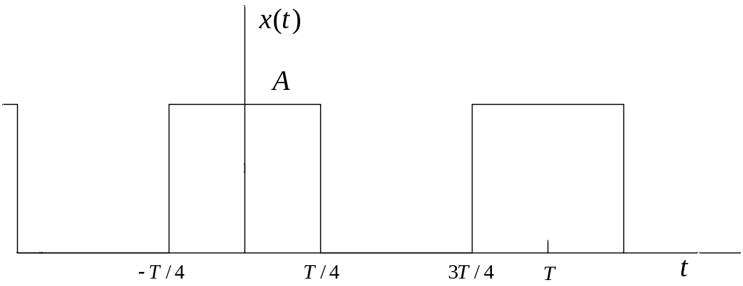
Periodic Function of Examples 16-4, 16-5, and 16-6.

Slide 17
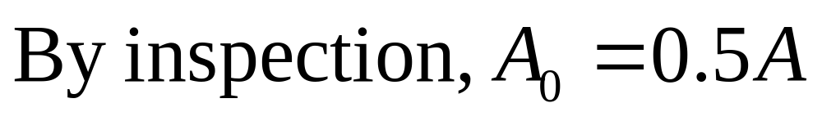
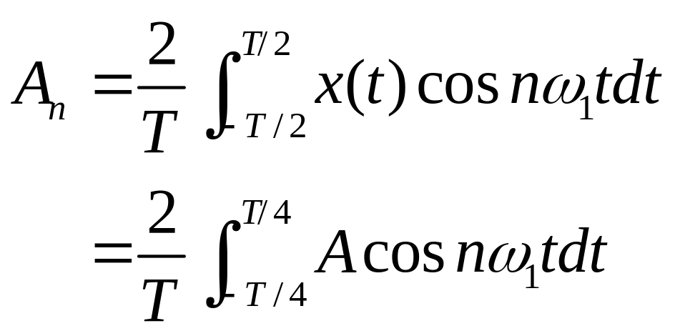
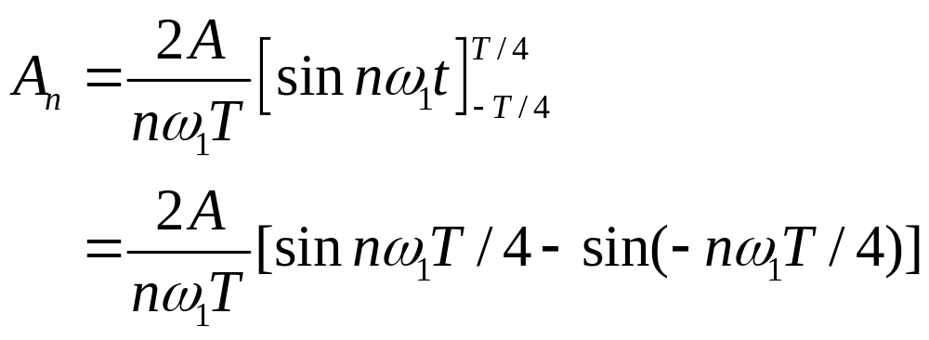
Example 16-4. Determine Fourier series.

Slide 18
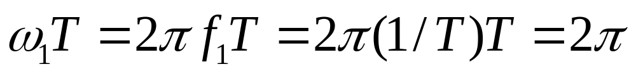
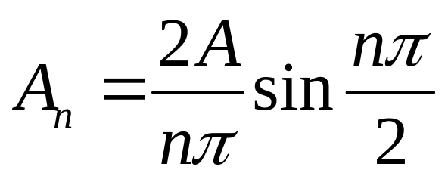
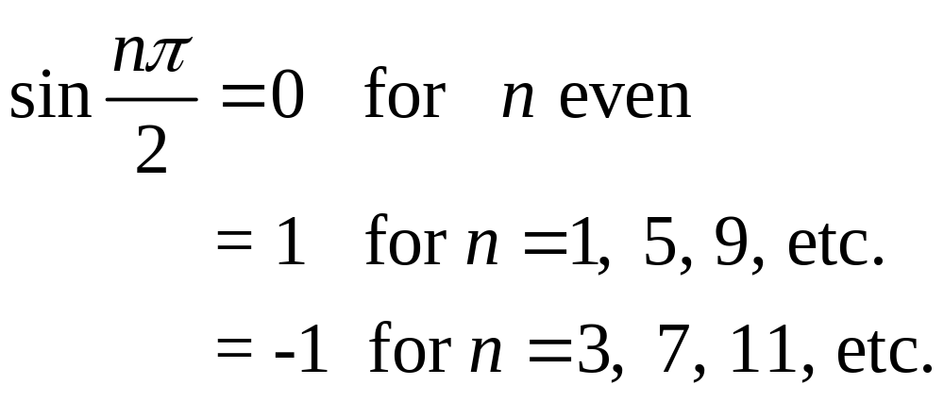
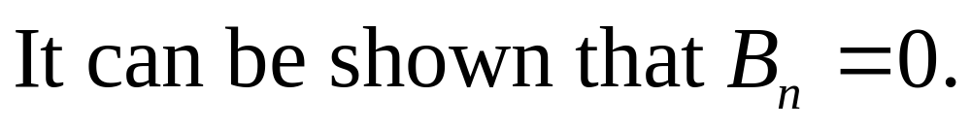
Example 16-4. Continuation.

Slide 19
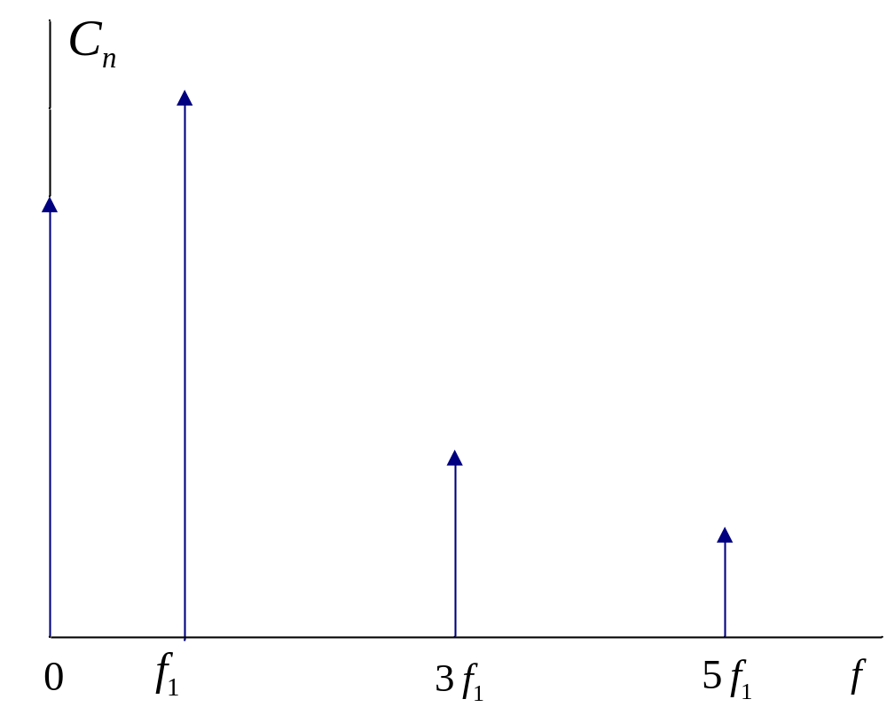
Example 16-5. One-Sided Spectral Plot

Slide 20
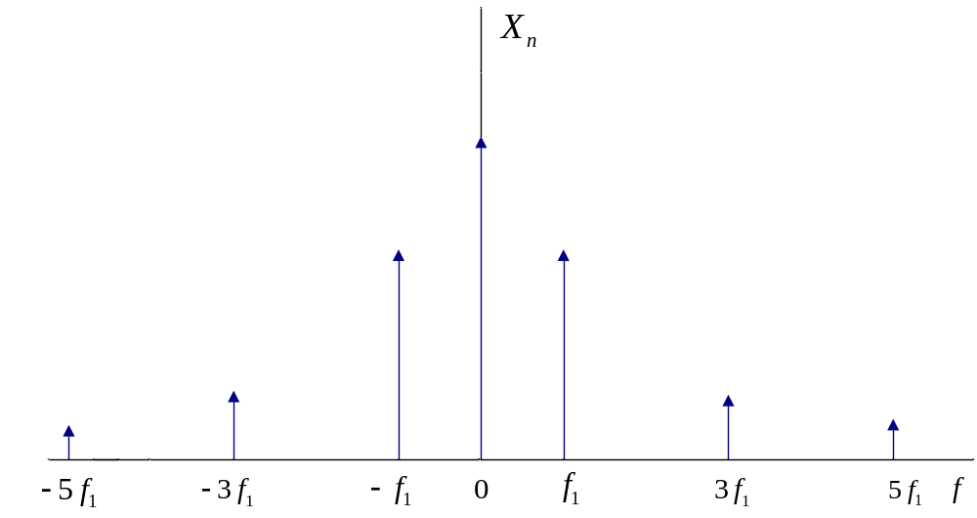
Example 16-6. Two-Sided Spectral Plot

Slide 21
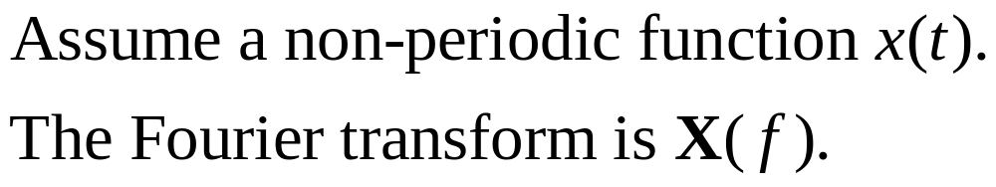
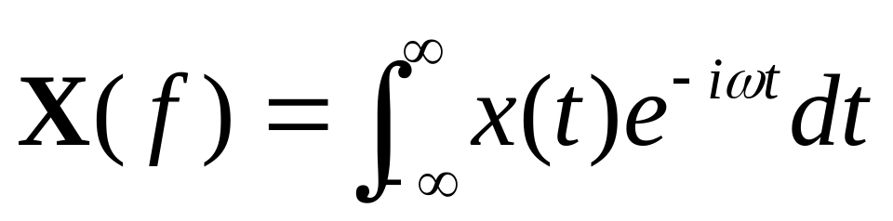
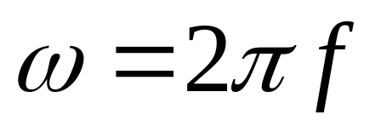
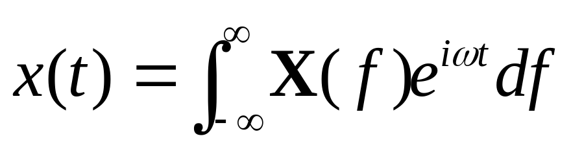
Fourier Transform

Slide 22
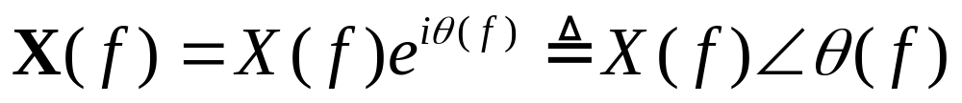
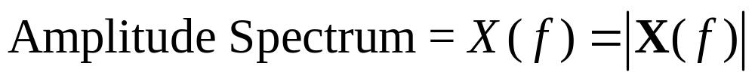
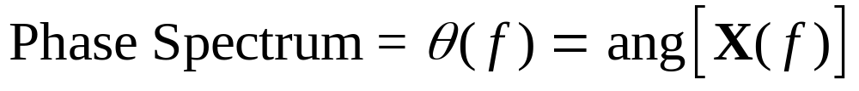
Amplitude and Phase Spectra

Slide 23
Comparison of Fourier Series and Fourier Transform
The Fourier series is usually applied to a periodic function and the transform is usually applied to a non-periodic function.
The spectrum of a periodic function is a function of a discrete frequency variable.
The spectrum of a non-periodic function is a function of a continuous frequency variable.

Slide 24
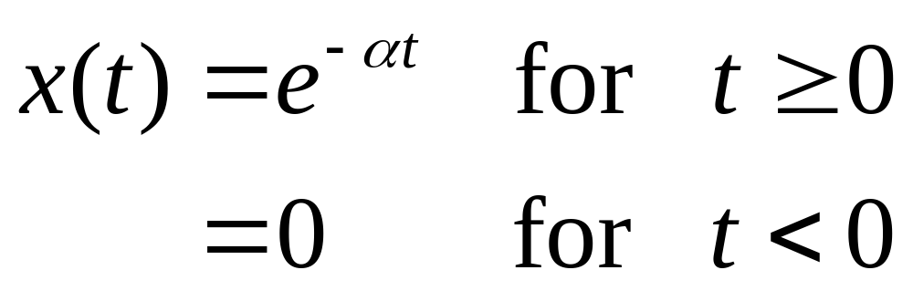
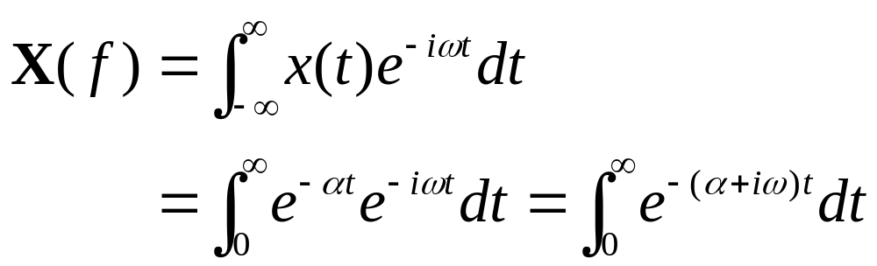
Example 16-7. Determine the Fourier transform of the function below.

Slide 25
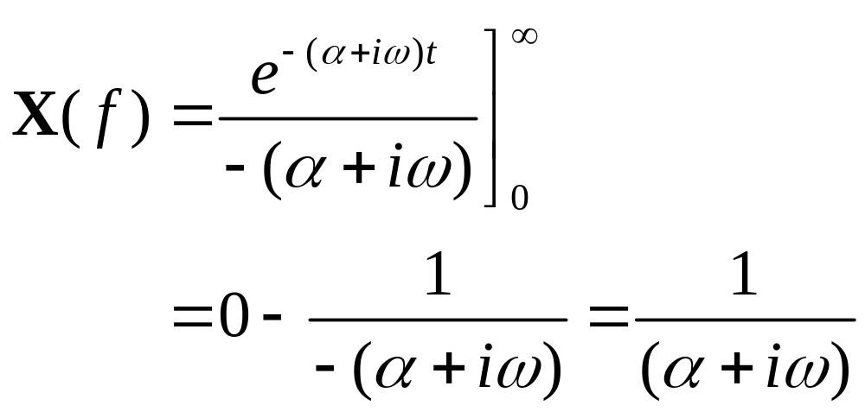
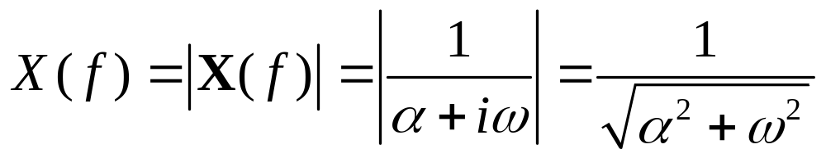
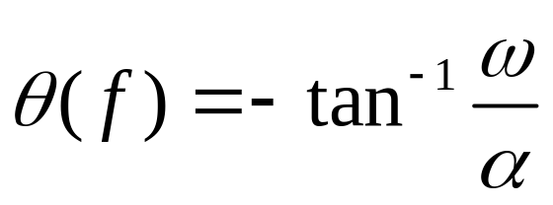
Example 16-7. Continuation.

Slide 26
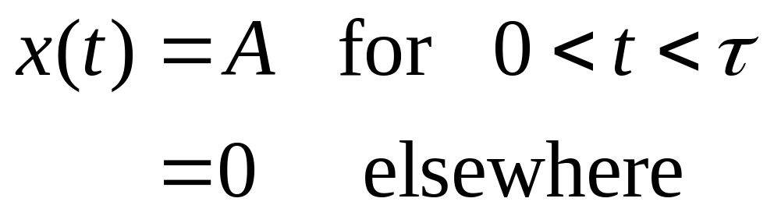
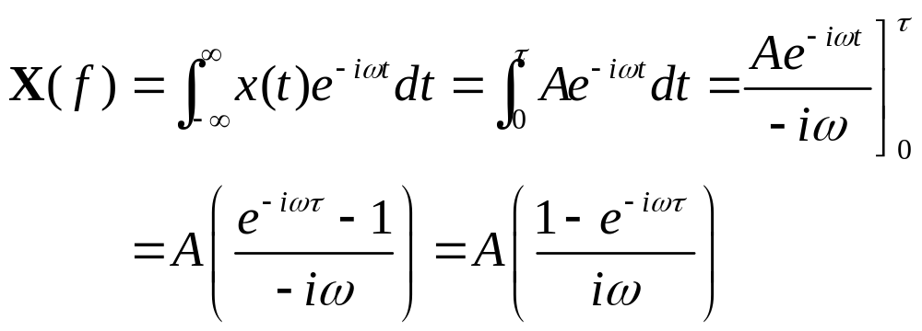
Example 16-8. Determine the Fourier transform of the function below.

Slide 27



Example 16-8. Continuation.

Slide 28
Discrete and Fast Fourier Transforms
The discrete Fourier transform (DFT) is a summation that produces spectral terms that may be applied to either periodic or non-periodic functions.
The fast Fourier transform (FFT) is a computationally efficient algorithm for computing the DFT at much higher speeds.
The IDFT and IFFT are the corresponding inverse transforms.

Slide 29


Sampled Signal

Slide 30




Definitions of DFT and IDFT

Slide 31
Initial Assumptions for MATLAB
The function must be interpreted as periodic.
It is recommended that the number of points N be even.
The spectrum will also be periodic. It will be unique only at N/2 points.
The integer for a MATLAB indexed variable must start at a value of 1.
The highest unambiguous frequency corresponds to a MATLAB index of N/2.

Slide 32


Slide 33


Slide 34


Slide 35


Slide 36


Slide 37


